Slide 1

P-205 Bankruptcy Prevention
Mentor:
Mr. Rajashekar Madishetty
Ms. Pallavi Bapuram
Team:
Ms. Prajakta Ramesh Patil
Ms. Sana Shaikh
Ms.Rohini Govind Arkhade
Ms.Shital Sitaram Dhindale
Ms.Sakshi Avadhoot Barve
Ms. Sanyukta Prakash Borkar

Slide 2

CONTENTS
Business Objective
Project Architecture
Data Collection & Details
Exploratory Data Analysis
Visualizations
Modeling
Evaluation
Deployment

Slide 3
BUSINESS OBJECTIVE
This is a classification project, since the variable to predict is binary (bankruptcy or non-bankruptcy). The goal here is to model the probability that a business goes bankruptfrom different features.
The data file contains 7 features about 250 companies
The data set includes the following variables:
1. industrial_risk: 0=low risk, 0.5=medium risk, 1=high risk.
2. management_risk: 0=low risk, 0.5=medium risk, 1=high risk.
3. financial flexibility: 0=low flexibility, 0.5=medium flexibility, 1=high flexibility.
4. credibility: 0=low credibility, 0.5=medium credibility, 1=high credibility.
5. competitiveness: 0=low competitiveness, 0.5=medium competitiveness,
1=high competitiveness.
6. operating_risk: 0=low risk, 0.5=medium risk, 1=high risk.
7. class: bankruptcy, non-bankruptcy (target variable).

Slide 4
Project Architecture / Project Flow
Business Understanding
Data Collection
Data Preparation
Exploratory Data Analysis
Model Evaluation
Model Deployment

Slide 5
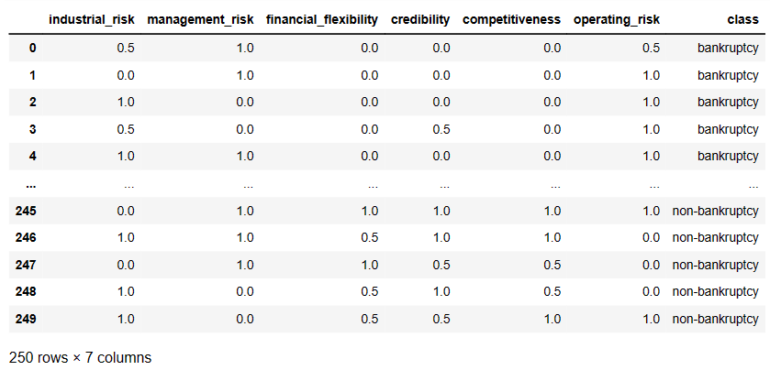
Data Collection & Details
The data file contains 7 features
industril risk
managemnt risk
financial flexibility
credibility
competitiveness
operating risk
class
250 rows & 7 columns

Slide 6
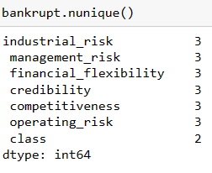
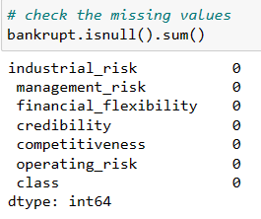

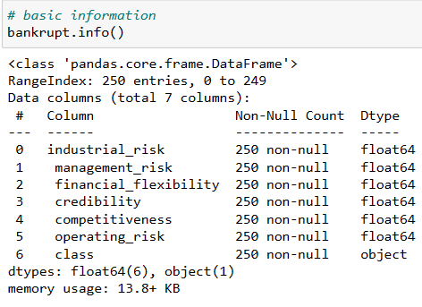
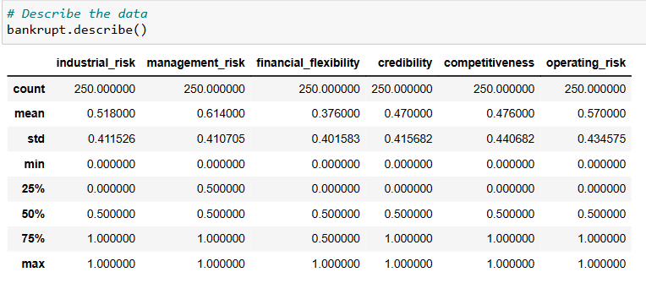
Describe the Dataset
Unique values for each column
Missing values
Shape
Information
Describe tha data

Slide 7

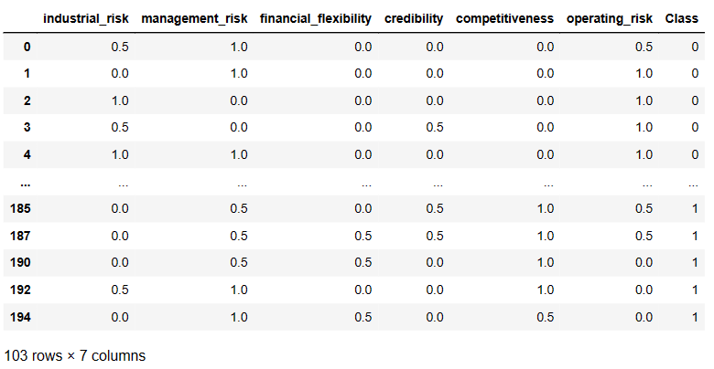
Data Cleaning
Checking Dulicates Row
After droping duplicates rows we have 103 rows & 7 columns , then for visualization we created a Class column and we are changing the target variable to bankruptcy=0 , non-bankruptcy=1 and remove the column which are not required for analysis

Slide 8
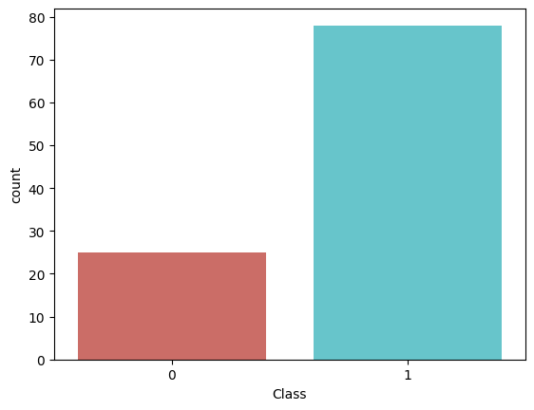
Visualization
Countplot for Class
Bankruptcy = 0
Non-bankruptcy = 1

Slide 9
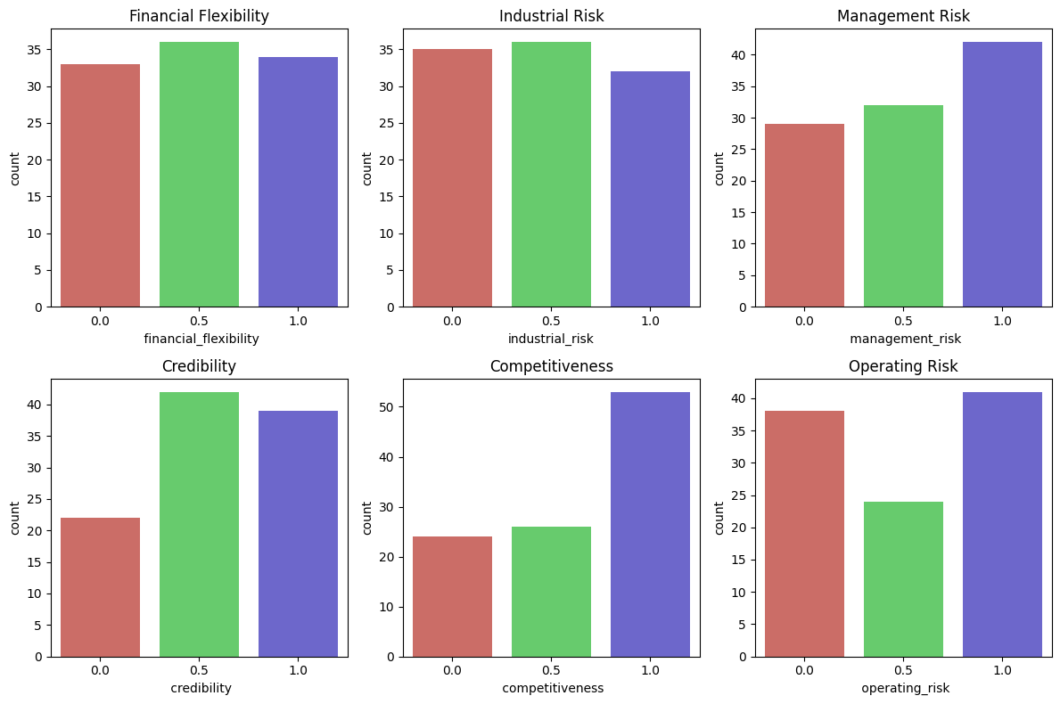
The countplot is a bar plot that shows the number of occurrences of each category in a categorical variable. By Looking at this histogram we can say that we have higher risks than credibility and competitiveness

Slide 10
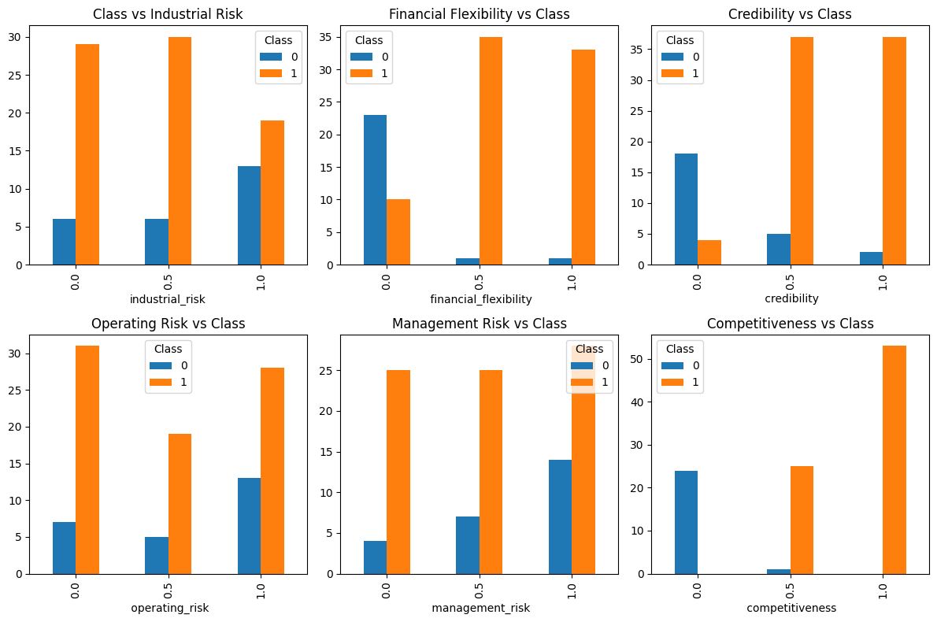
To create a contingency table (also known as a cross-tabulation table) that shows the frequency distribution of the two variablesand The resulting table shows the number of instances of each combination of values between the each feature to class.

Slide 11
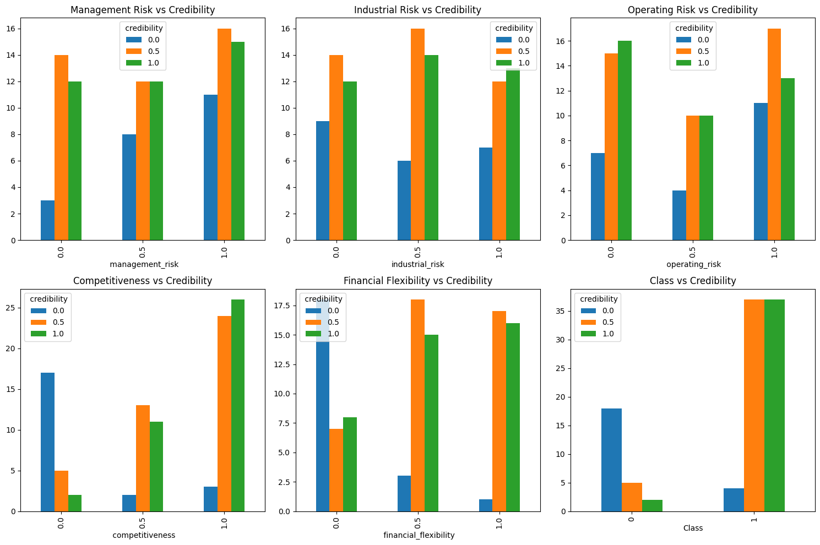
To visualize the relationship between two categorical variables in a DataFrame and to identify any patterns or trends in the data and to compare the distribution of one variable across different categories of another variable.

Slide 12
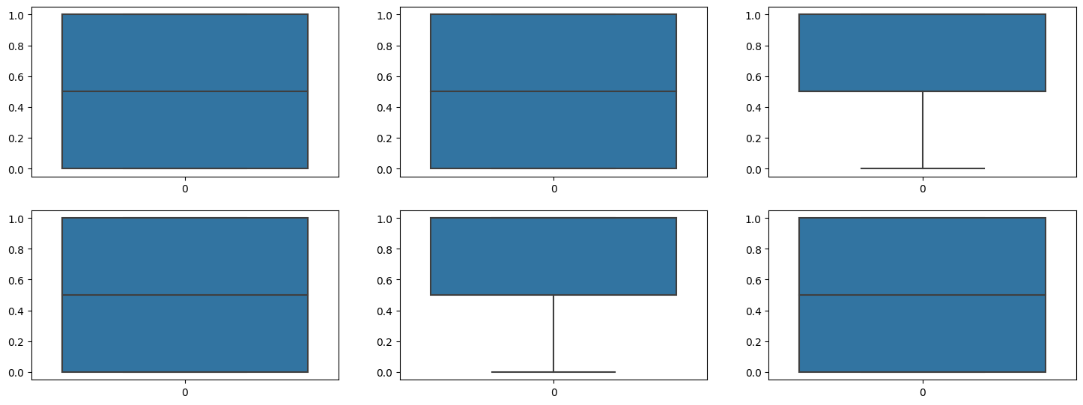
Finding outliers using box plot

Slide 13
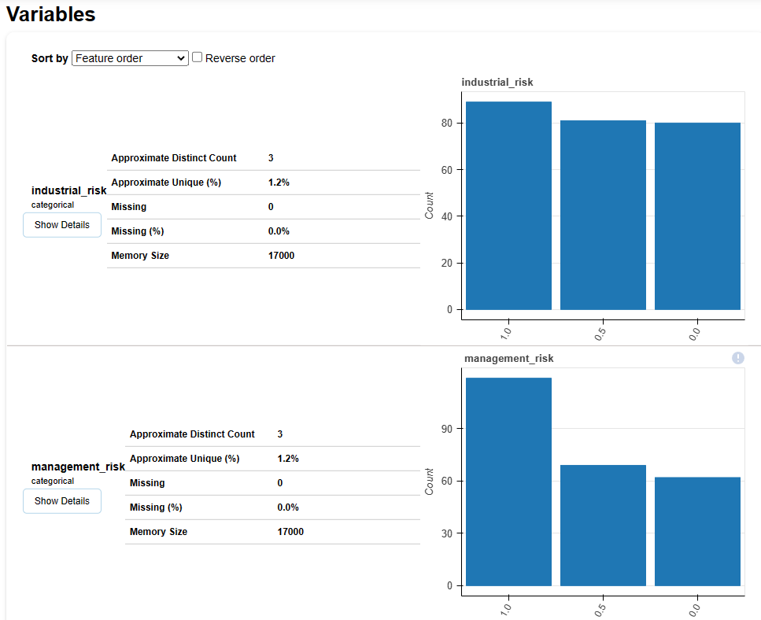
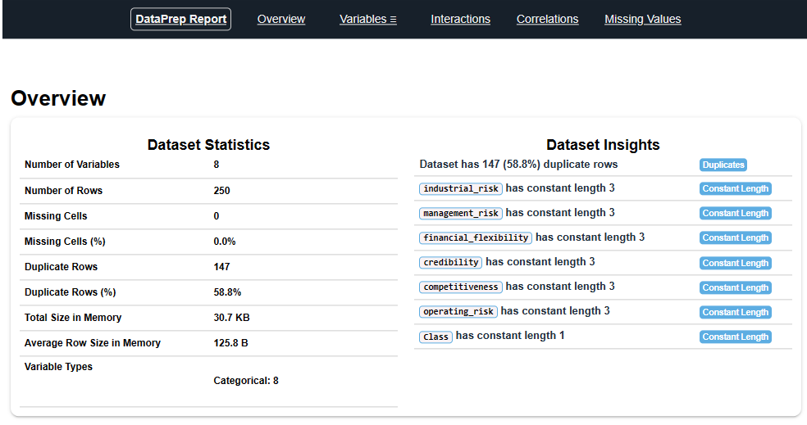
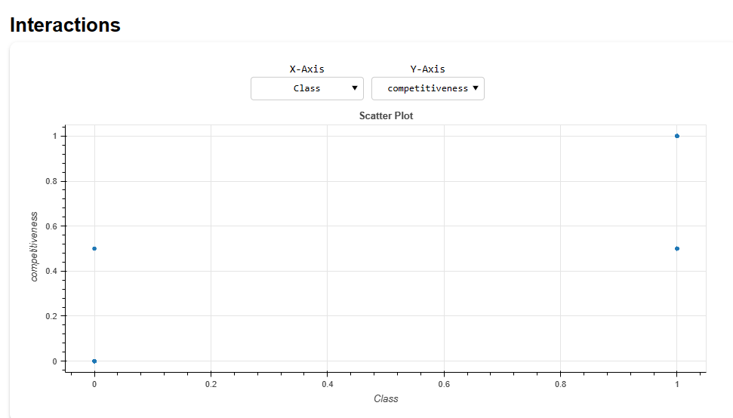
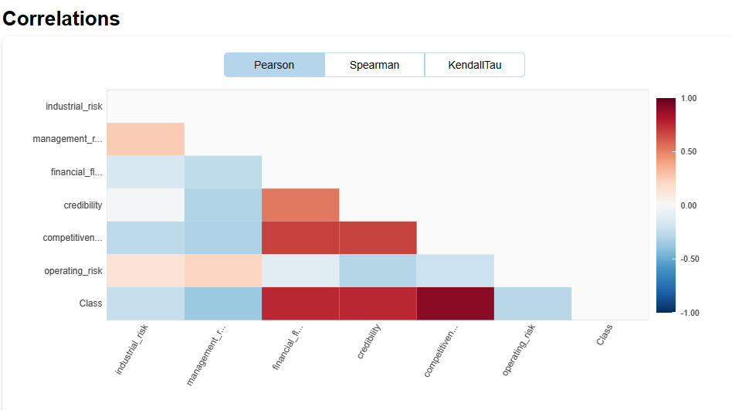
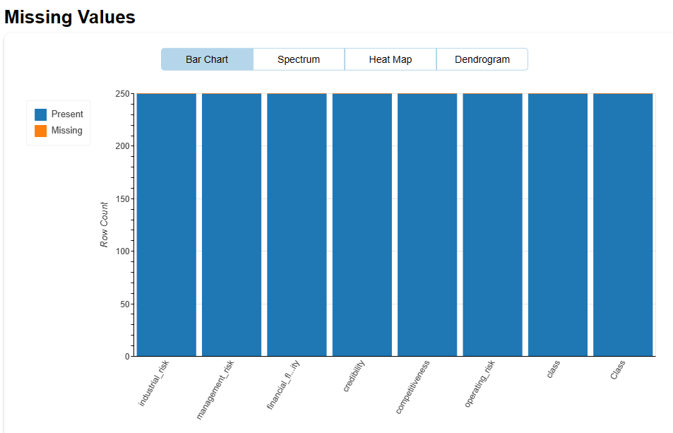
creating automatic EDA using dataprep

Slide 14

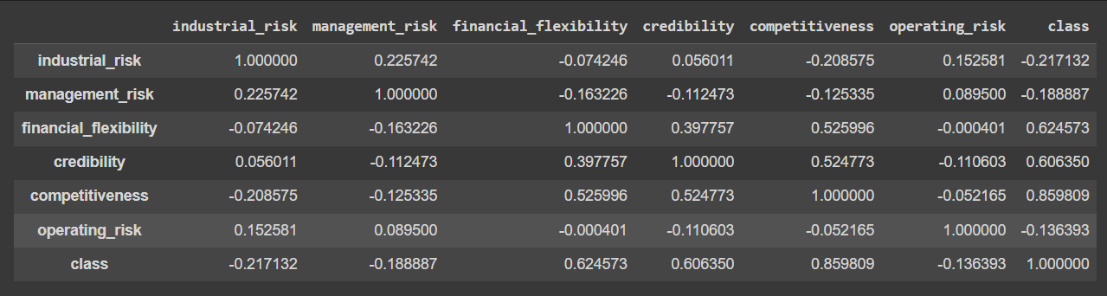
Correlation - EDA
The correaltion among the variables, we can make use of the correlation function. This will give you a fair idea of the correlation strength between different variables.

Slide 15
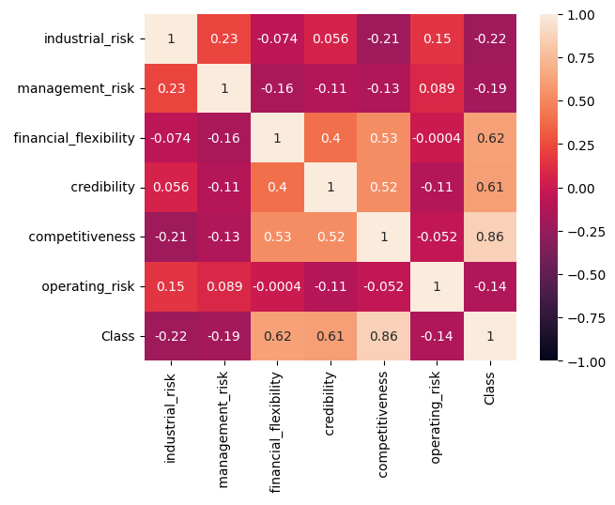
Correlation plot
This is the correlation matrix with the range from +1 to -1 where +1 is highly positively correlated and -1 will be highly negatively correlated.

Slide 16
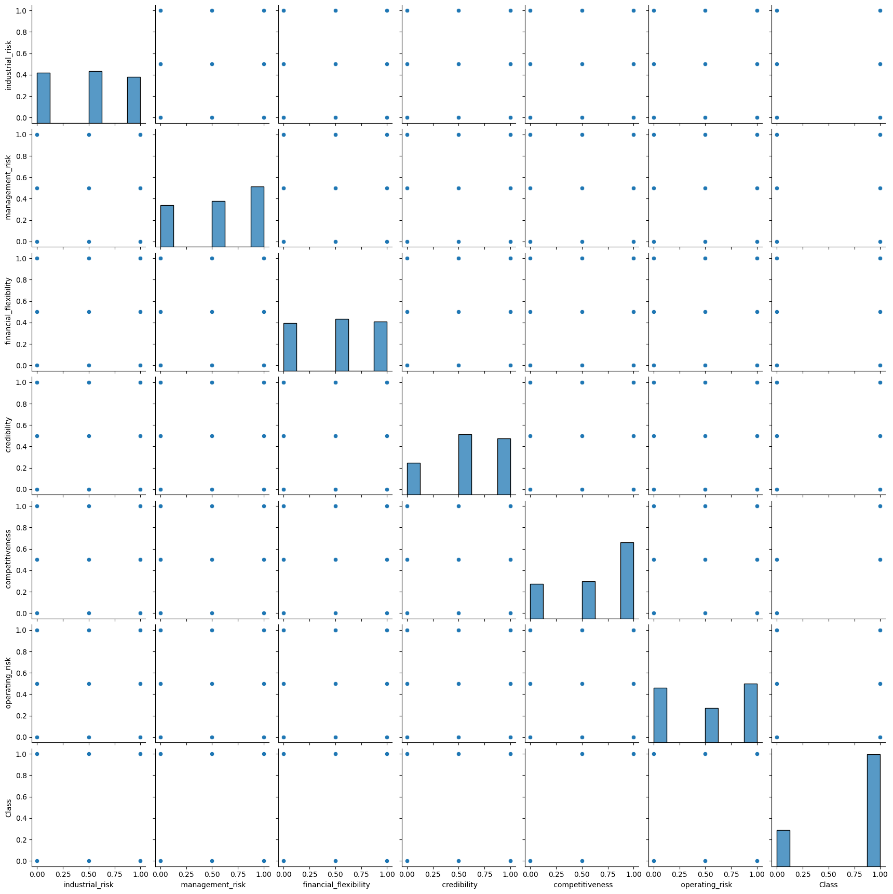
Pairplot

Slide 17
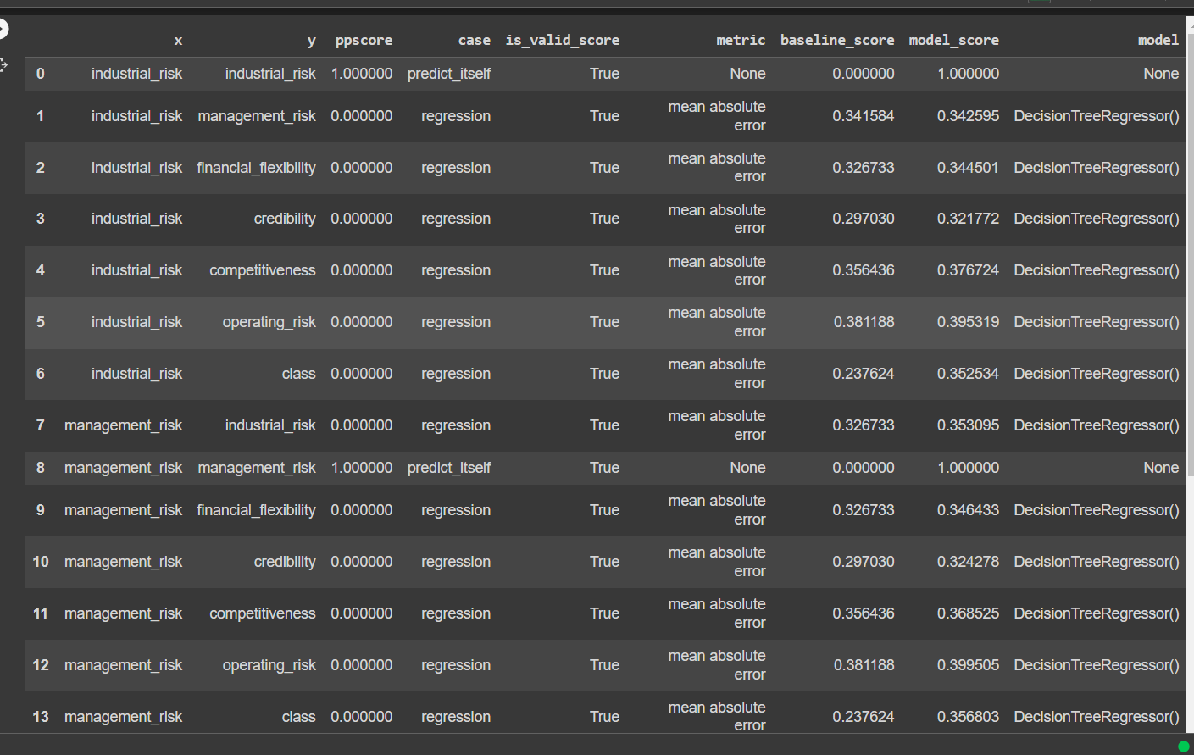
PPS Score

Slide 18
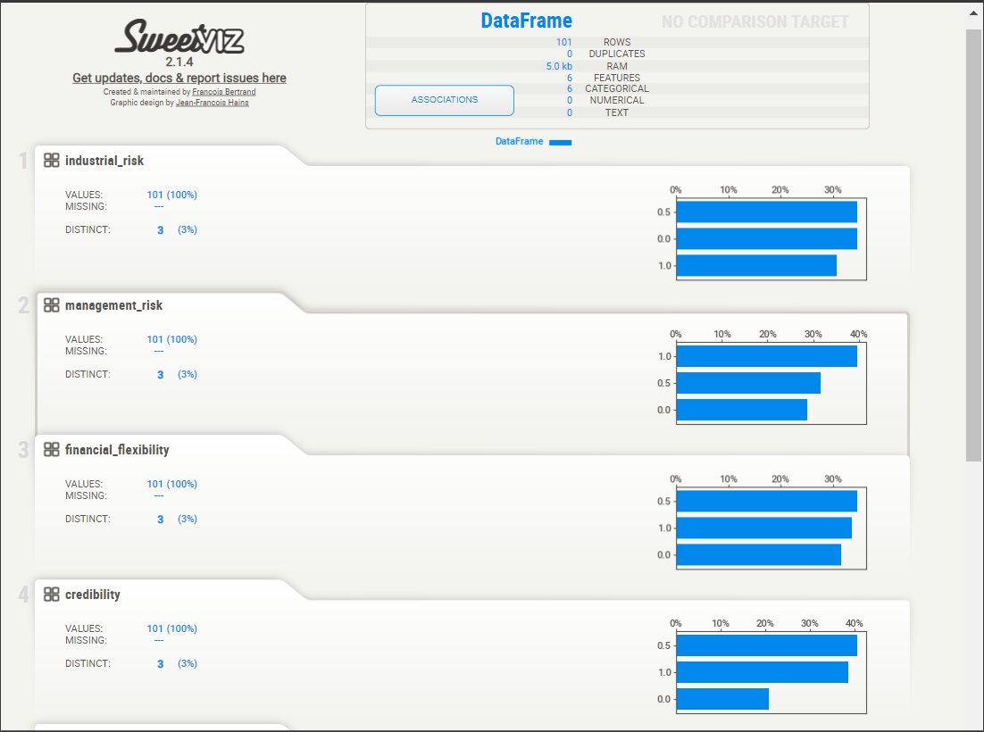
SWEETVIZ REPORT

Slide 19
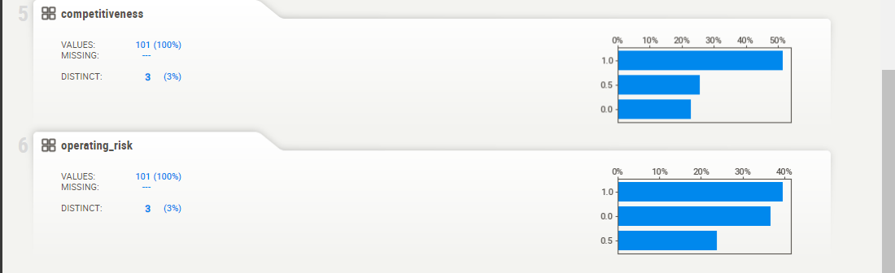
Competitiveness & Operating_risk
Sweetviz is an open-source Python library that generates beautiful , high-density visualizations to kickstart EDA (Exploratory data analysis) with just two lines of code. Output is a fully self – contained HTML application.

Slide 20
Model Building
Decision Tree Classifier,
Random Forest Classifier,
SVC
Logistic Regression,
Kneighbours Classifier,
Bagging Classifier,
Gradient Boosting Classifier,
ExtraTreesClassifier

Slide 21
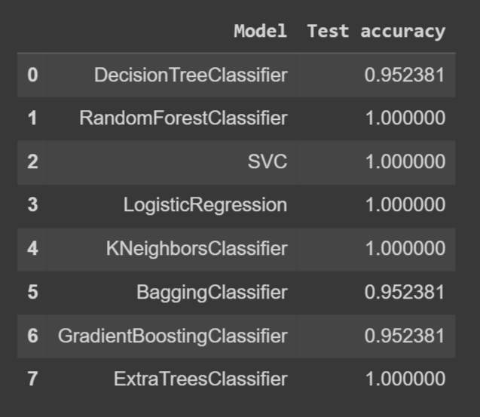
Accuracy of Whole Models

Slide 22
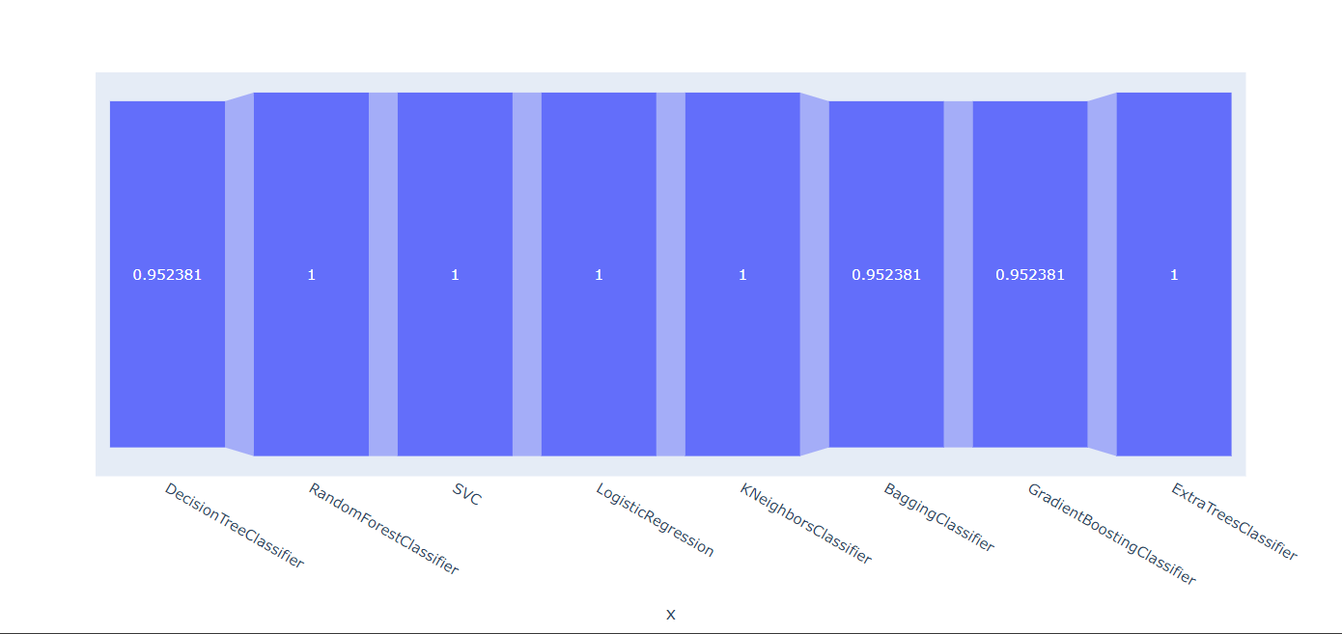
Comparison Between Models Accuracy Using Plotting

Slide 23


